Slide 1

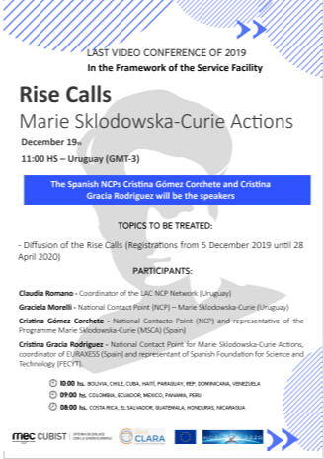

Acciones RISE
Marie Sklodowska-Curie (MSCA)
Horizonte 2020
Madrid, 19 de diciembre 2019
Cristina Gómez, NCP España, MSCA
Oficina Europea FECYT

Slide 2

CONTENT
Estadísticas y ejemplos MSCA RISE
Algunas pautas necesarias para escribir una buena propuesta
Enlaces y documentación de interés

Slide 3
I. Estadísticas y ejemplos MSCA RISE

Slide 4
I. Propuestas enviadas Convocatorias RISE 2014 - 2019
 | 2014 | 2015 | 2016 | 2017 | 2018 | 2019
Nº of Proposals submitted | 203 | 363 | 367 | 326 | 275 | 308

Slide 5
I. Notas de Corte MSCA RISE 2014 - 2019
PANEL | 2019 | 2018 | 2017 | 2016 | 2015 | 2014
CHE | 88,8 | 84,2 | 86,4 | 89 | 86,4 | 82,6
ECO | 77,4 | 95 | 86 | 81 | 88 | 70,6
ENG | 86,2 | 85,4 | 83,2 | 83,2 | 84,6 | 78,6
ENV | 88,8 | 84,4 | 88,6 | 91,2 | 90,8 | 78,4
LIF | 88,6 | 78,6 | 84,8 | 82,8 | 81,4 | 78,2
MAT | 86,2 | 81,4 | 86,6 | 83,2 | 84,6 | 76,4
PHY | 87 | 87 | 85,4 | 87,6 | 88,6 | 81,4
SOC | 91 | 81 | 82,6 | 90,8 | 88,2 | 77,2
2018 Call Success Rate: 26,84%
2019 Call Success Rate: 22%
*Provisional results

Slide 6
I. Número de proyectos financiados MSCA RISE 2014 - 2019
PANEL | 2019 * | 2018 | 2017 | 2016 | 2015 | 2014
CHE | 8 | 6 | 7 | 9 | 9 | 11
ECO | 2 | 1 | 3 | 4 | 3 | 4
ENG | 25 | 25 | 27 | 28 | 26 | 24
ENV | 8 | 9 | 10 | 9 | 10 | 11
LIF | 7 | 12 | 12 | 11 | 18 | 15
MAT | 2 | 2 | 3 | 3 | 4 | 1
PHY | 6 | 6 | 7 | 7 | 11 | 8
SOC | 9 | 12 | 11 | 13 | 8 | 10
Financiados | 67 | 73 | 80 | 84 | 89 | 84
Recibidos | 308 | 275 | 326 | 367 | 363 | 203
*Provisional results
Tasa de éxito convocatoria 2018: 26,84%
Tasa de éxito convocatoria 2019: 22%
Notes:
.

Slide 7
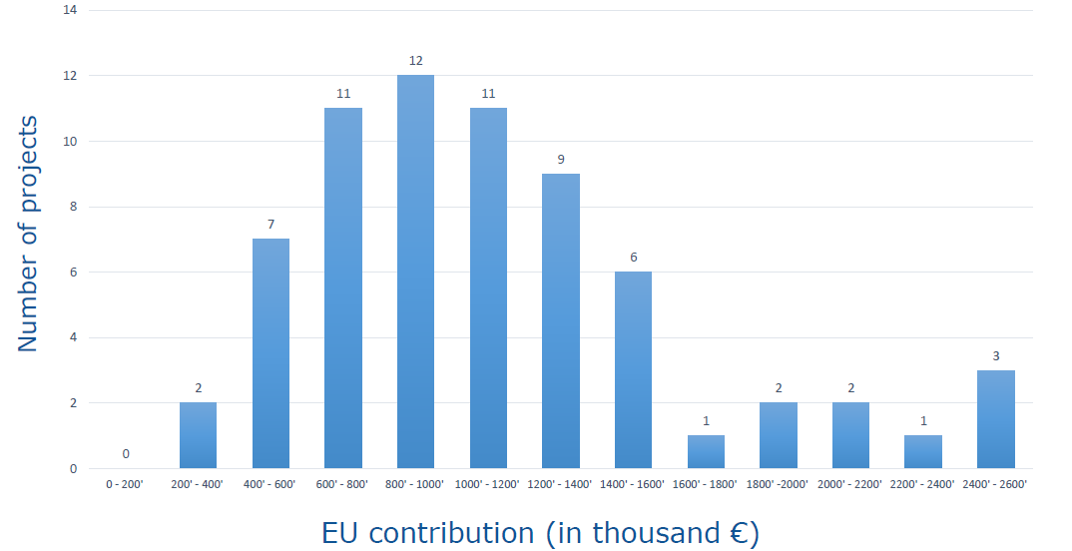
I. Tamaño de proyectos – Contribución EU – RISE 2019

Slide 8
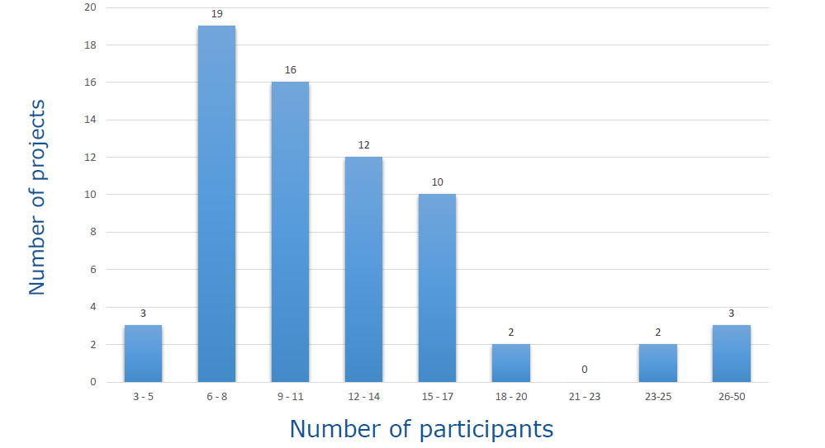
I. Tamaño de los proyectos – Número de participantes - RISE 2019
No ‘typical’ RISE project size –the largest supported RISE project is 40 times larger than the smallest
RISE averages:10.1 participants
Notes:
.

Slide 9
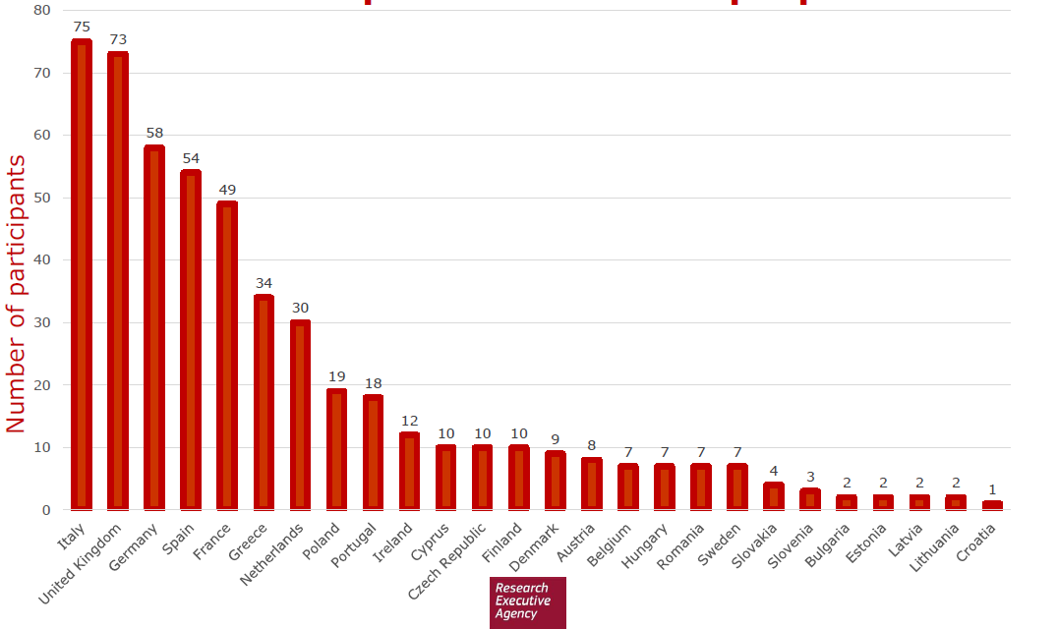
I. Participaciones EM– Proyectos Financiados - RISE 2019
Source: EC RISE PC October 2019

Slide 10
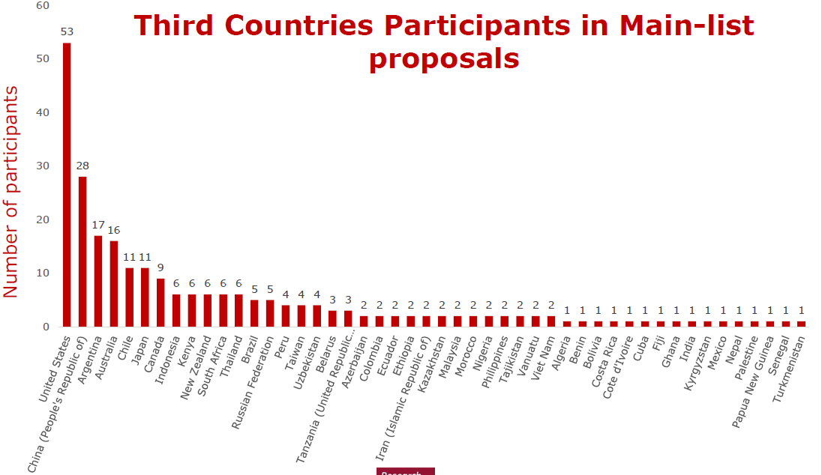
I. Participaciones TP– Proyectos Financiados - RISE 2019
2018
Source: EC RISE PC October 2019

Slide 11
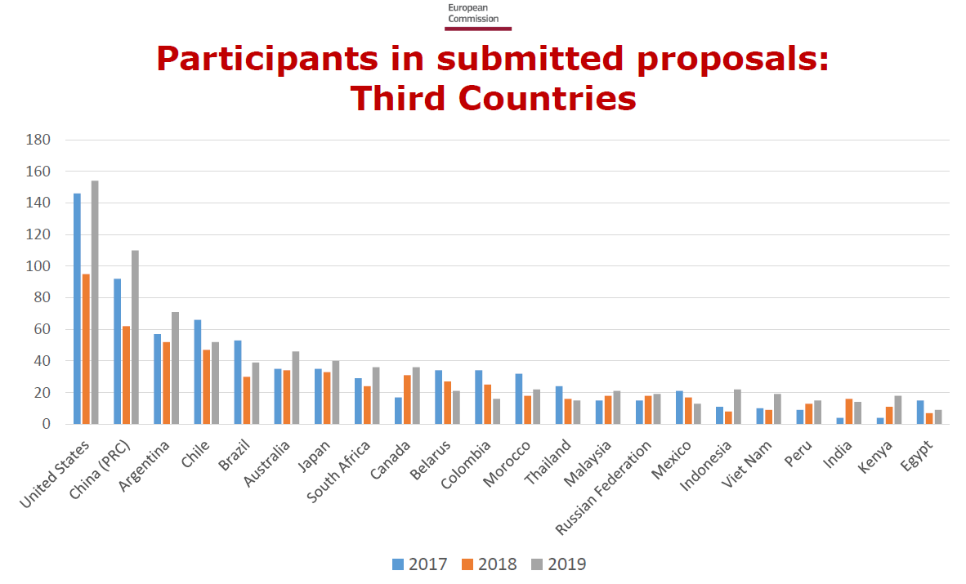
I. Participaciones TP– Proyectos Enviados 2017 a 2019
2018
Source: EC RISE PC October 2019

Slide 12
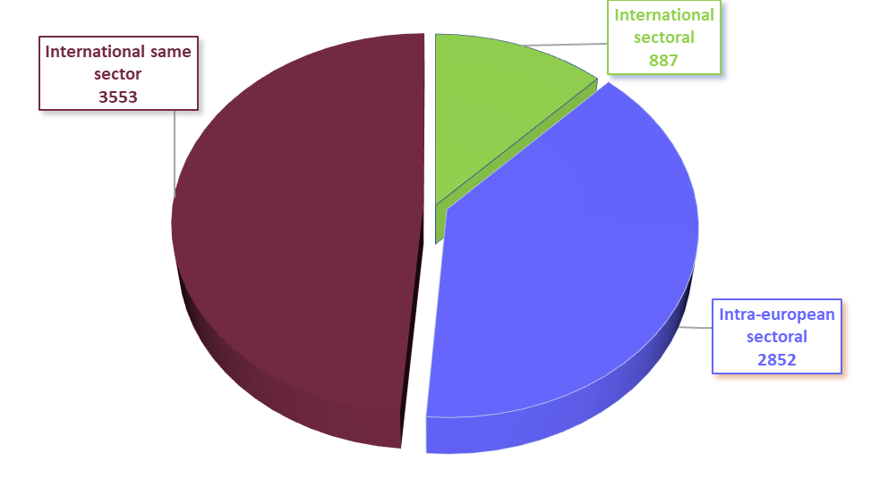
I. Tipo de movilidad en estancias - RISE 2019
12%
39%
49%
International:61%
Intra-european: 39%
Source: EC RISE PC October 2019

Slide 13
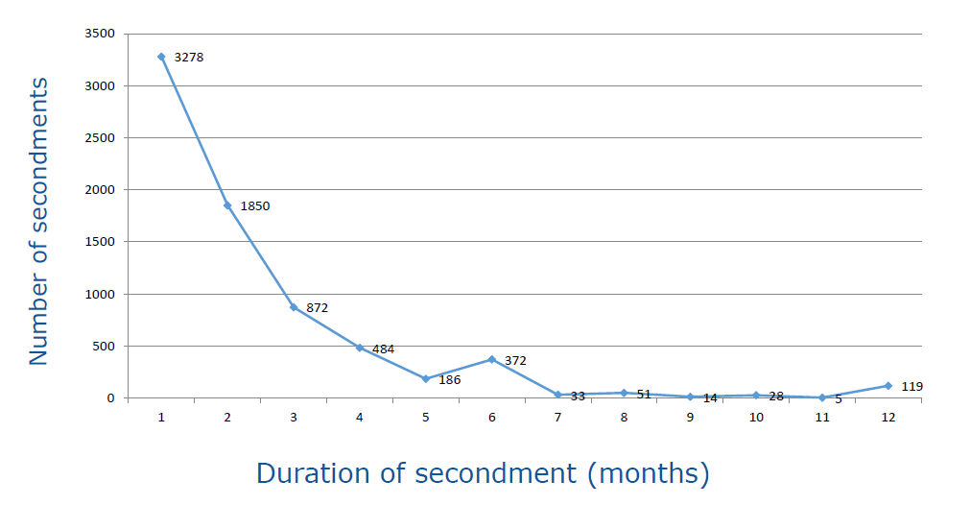
I. Duración de las estancias - RISE 2019
Average of 2.4 month secondment length
Source: EC RISE PC October 2019

Slide 14
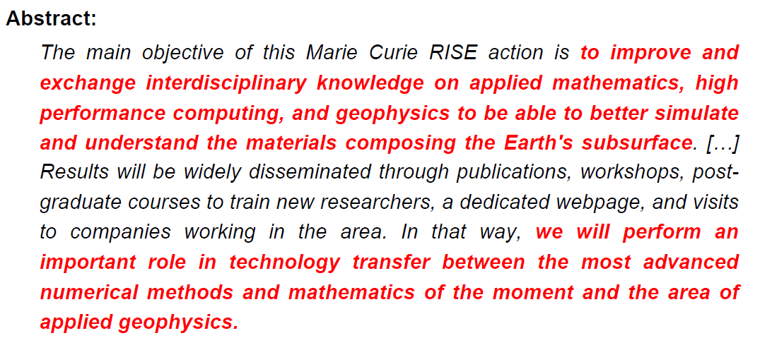


I. Proyecto GEAGAM: Geophysical Exploration using Advanced Galerkin Methods

Slide 15
I. GEAGAM: estancias
Academic MS/AC
Non-Academic MS/AC
Third Countries
Universidad de Chile (CL)
BCAM (ES)
TOTAL SA (FR)
U. Pontifica Católica de Valparaiso (CL)
UPV/EHU (ES)
U. Técnica Federico Santa María (CL)
BSC (ES)
U. of Texas System (US)
INRIA (FR)
K.A. U. of Science and Technology (SA)
TC High income to MS/AC can occur in a RISE project, but must be paid for from another budget

Slide 16
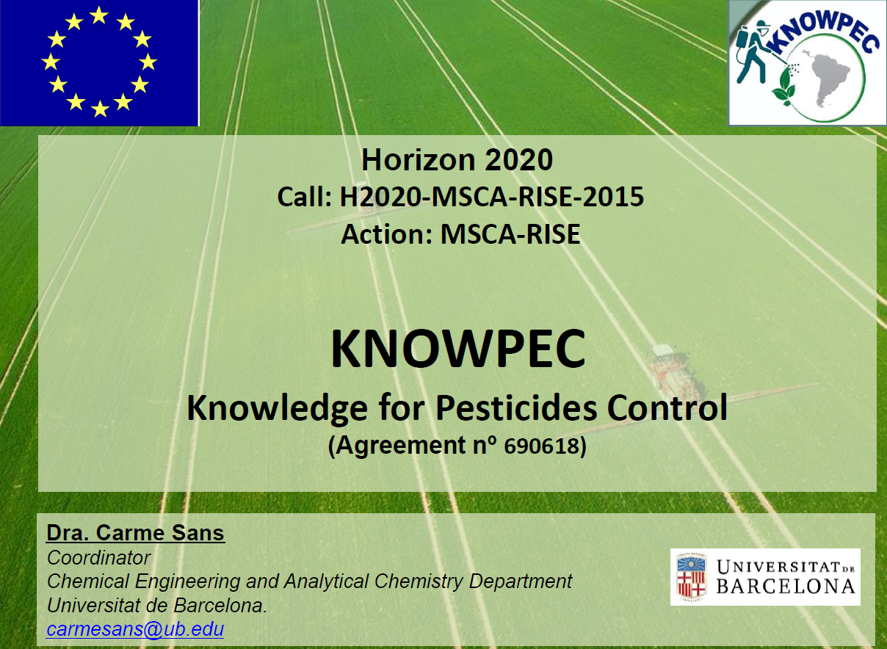
I. Proyecto KNOWPEC

Slide 17
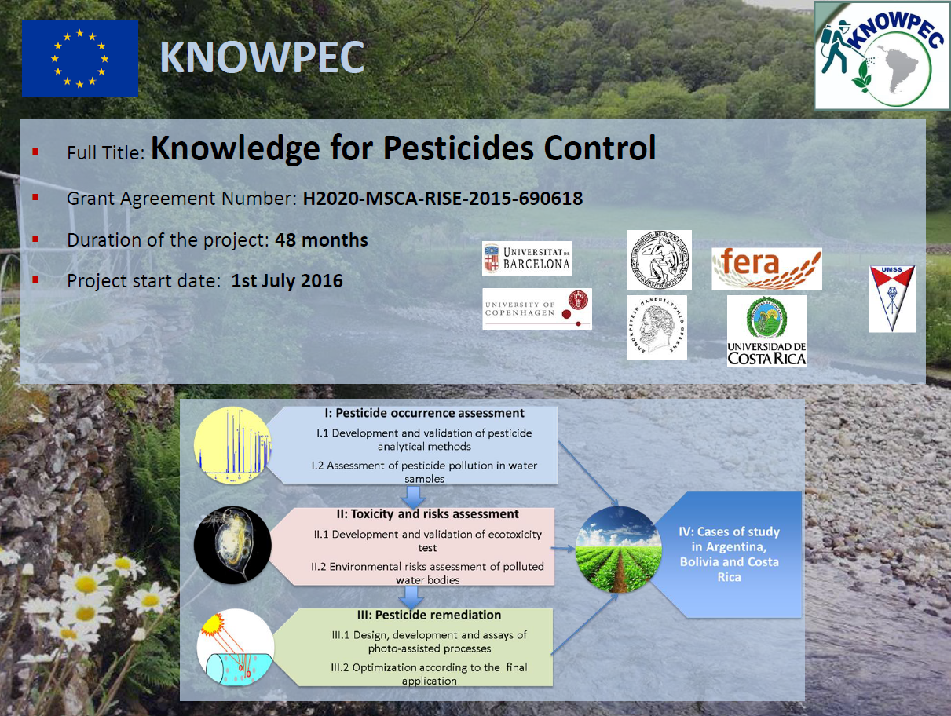
I. Ejemplo KNOWPEC
http://h2020-rise-knowpec.com/

Slide 18
II. Algunas pautas para escribir una buena propuesta:
¿Quién nos va a evaluar?
¿Cómo nos van a evaluar?

Slide 19
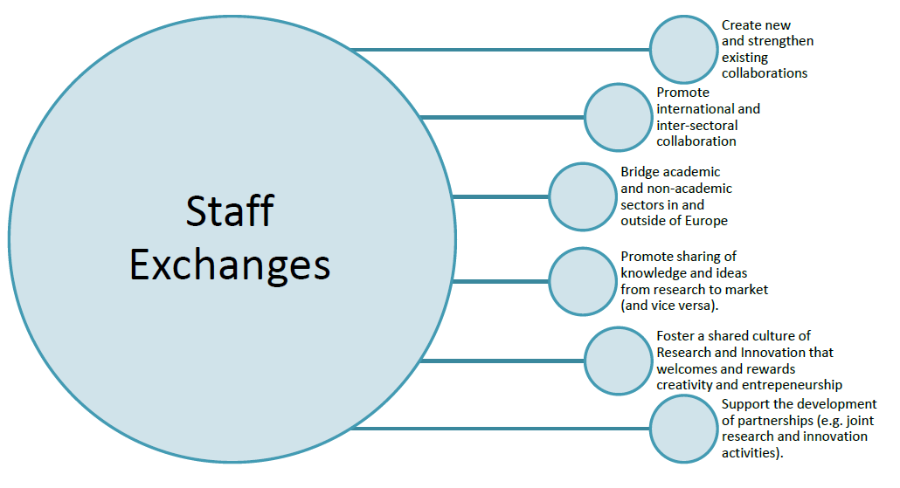
II. Recordemos los Objetivos RISE
Source: UKRO

Slide 20
II. Recordemos el impacto esperado en MSCA
STAFF MEMBER LEVEL
ORGANISATION LEVEL
SYSTEM LEVEL
Increased skills, both research-related and transferable ones, leading to improved employability and career prospects both in and outside academia
Increase in high impact R&I output, contribution to the knowledge-based economy and society
Enhanced cooperation and transfer of knowledge between sectors and disciplines
Strengthening of international and intersectoral collaborative networks
Boosting of R&I capacity among participating organisations
Increase in international, interdisciplinary and intersectoral mobility of researchers in Europe
Strengthening of Europe's human capital base and attractiveness as an R&I destination
Better quality R&I contributing to Europe's competitiveness and growth
Source: UKRO

Slide 21
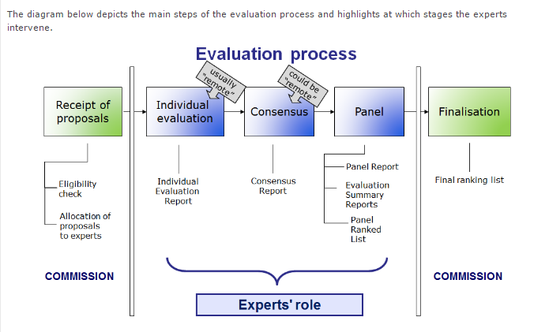

II. ¿Quién nos va a evaluar?
FULL REMOTE EVALUATION
3 evaluators per proposal;
2 Vice-Chairs (VCs) of which 1 is rapporteur, and 1 cross-reader;
SEP Hands-on Training for VCs;
Improved briefing for experts: web-briefing (unconscious bias added), Q&A chat sessions, evaluators guide, SEP guidance movie;
SEP workflow and functionalities adjusted to ease the remote consensus discussion;
Minority views: Specific slots for teleconferences will be foreseen in order to solve critical cases remotely, before the central phase.
3 experts with very different expertise
You need to “sell” your project while keeping the technical information right

Slide 22
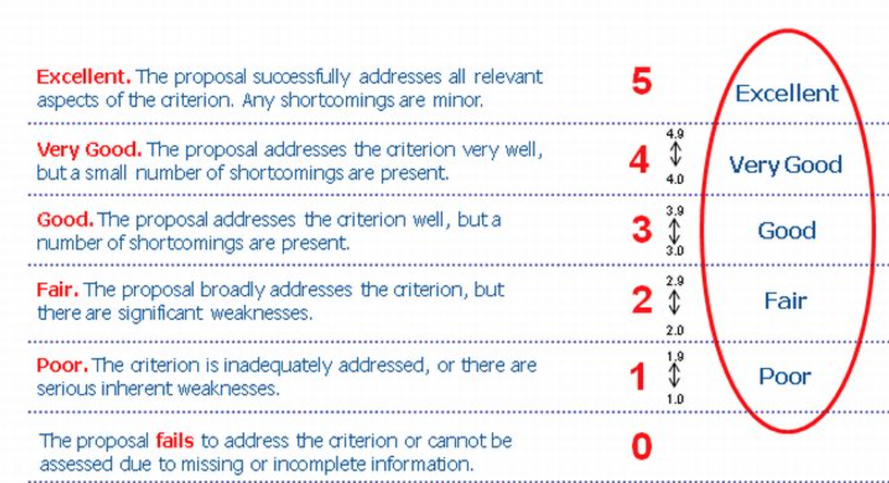
II. ¿Cómo nos van a evaluar?
Full scoring scale consistent with the comments
22

Slide 23
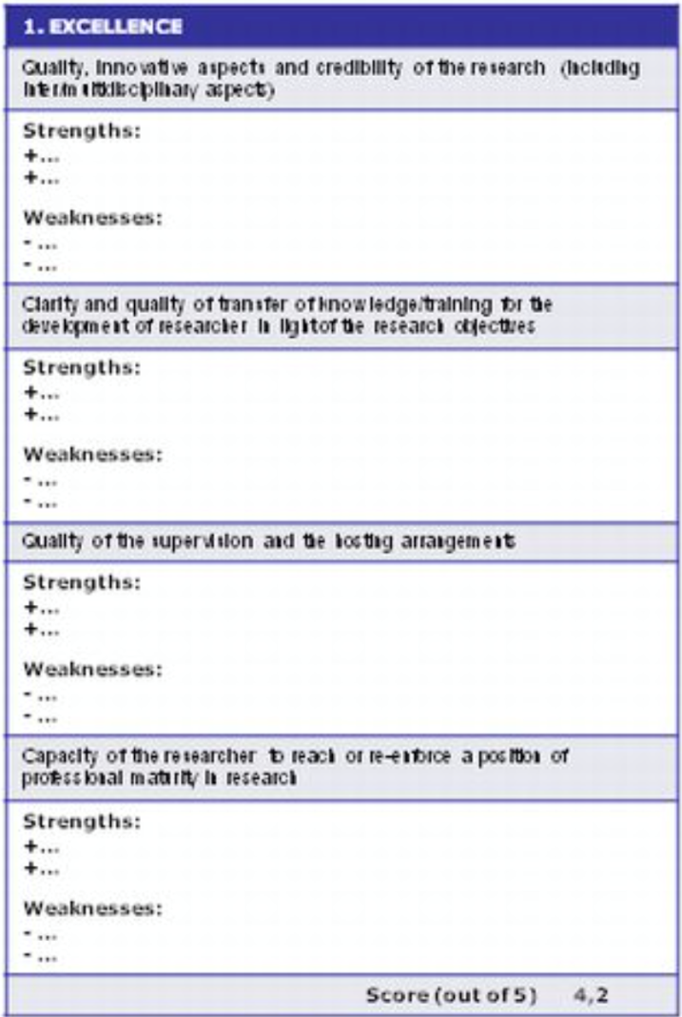
II. ¿Cómo nos van a evaluar?
Each expert draft a IER (individual evaluation report) for each proposal assigned
In the IER:
List strengths and weaknesses in bullet point format
Under each sub-criterion
For each criterion (excellence, Impact and Implementation)
They will Score each Criterion
23
Notes:
Los evaluadores emiten un informe individual en el que se indica en cada departamento aspectos de fortalezas y debilidades detectados así como la nota correspondiente.

Slide 24
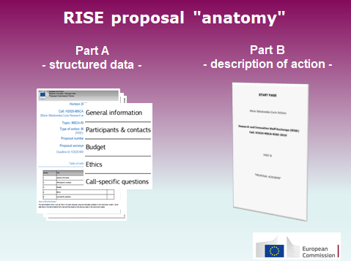
Proposal Part B
II. Estructura de la propuesta

Slide 25
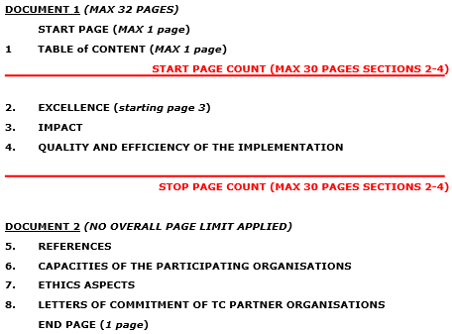
Proposal Part B
II. Estructura de la propuesta
30 page limit

Slide 26
II. Criterios Parte B
Excellence
Quality and credibility of the research/innovation project.
Quality and appropriateness of knowledge sharing.
Quality of the proposed interaction.
50%
Impact
Enhancing the potential and future career perspectives of the staff members.
Developing new and lasting research collaborations, to achieve transfer of knowledge between research institutions and to improve research and innovation potential at the European and global levels.
Quality of the proposed measures to exploit and disseminate the project results
Quality of the proposed measures to communicate the project activities to different target audiences.
30%
Implementation
Coherence and effectiveness of the work plan, including appropriateness of the allocation of tasks and resources
Appropriateness of the management structures and procedures including quality management and risk management.
Appropriateness of the institutional environment (hosting arrangements, infrastructure).
Competences, experience and complementarity of the participating organisations and their commitment to the project.
20%

Slide 27

III. ...¿y ahora?
European Industrial Doctorates
(EID)

Slide 28
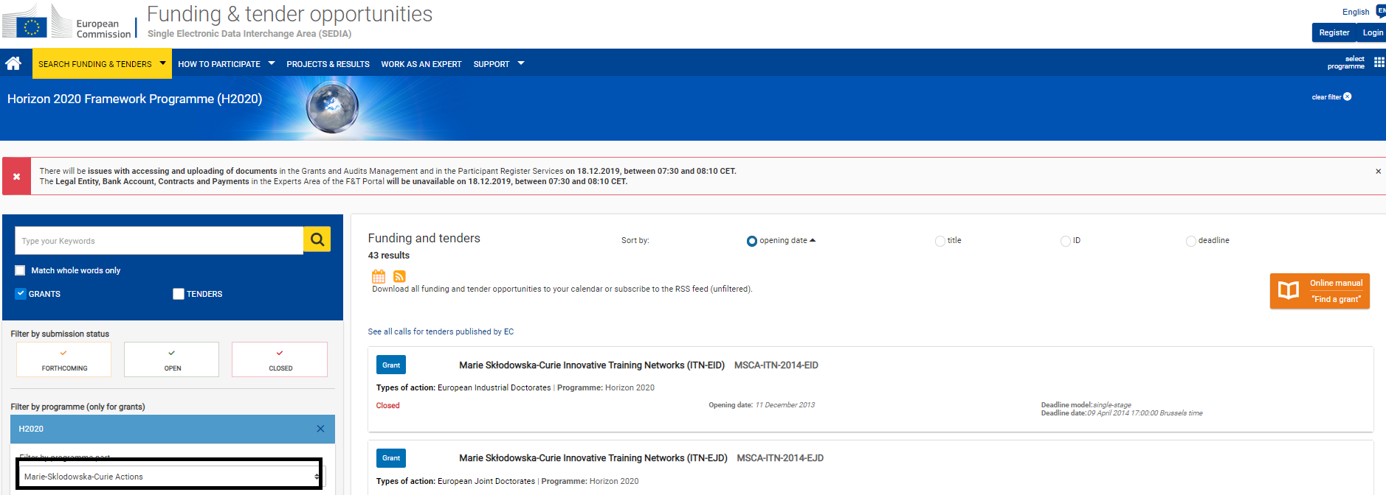
III. Funding and Tenders Portal
European Industrial Doctorates
(EID)
Website link

Slide 29
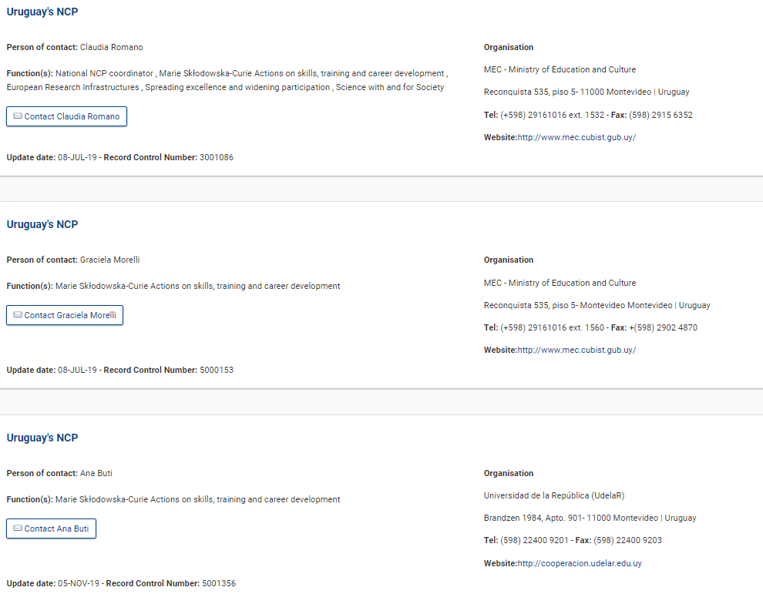
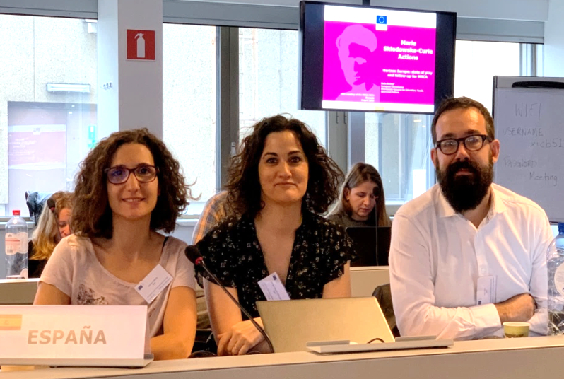
III. Contact your NCP!
https://ec.europa.eu/info/funding-tenders/opportunities/portal/screen/support/ncp
Informative and training sessions
Queries solving
Pre-screening of proposals
Managers Trained
MSCA Support
msca@oficinaeuropea.es

Slide 30


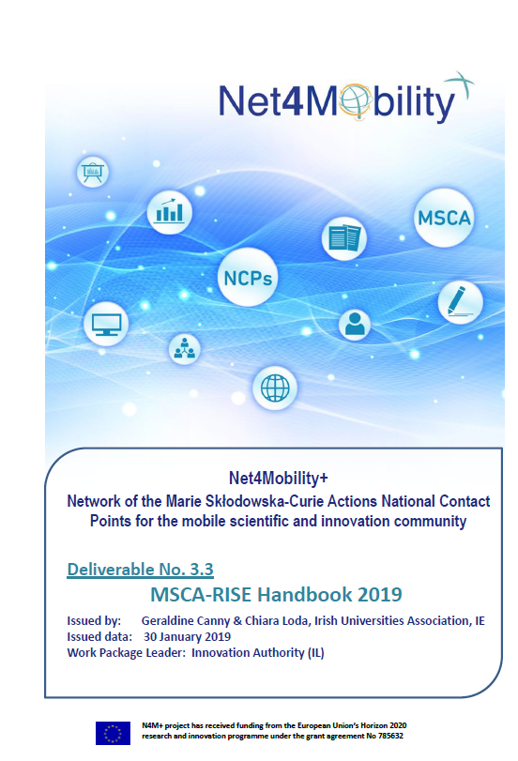

III. Net4Mobility+
Network of Horizon 2020 National Contact Points (NCP) for Marie Sklodowska-Curie Actions (MSCA).
https://www.net4mobilityplus.eu/
@Net4Mobility
Youtube Channel
Document link

Slide 31

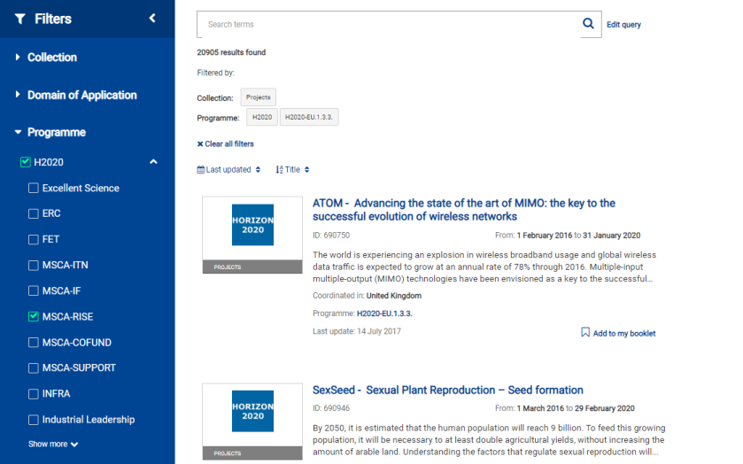
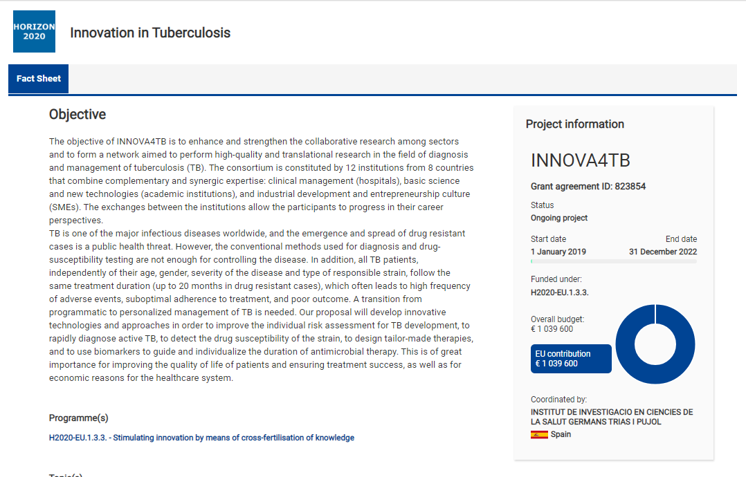
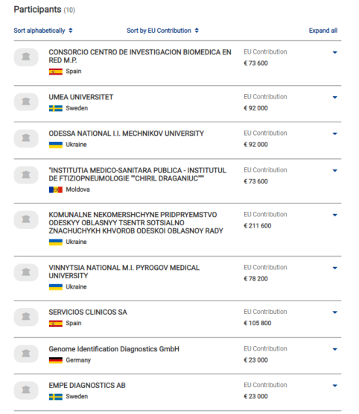
III. CORDIS - Projects and Results
https://cordis.europa.eu/projects/en

Slide 32
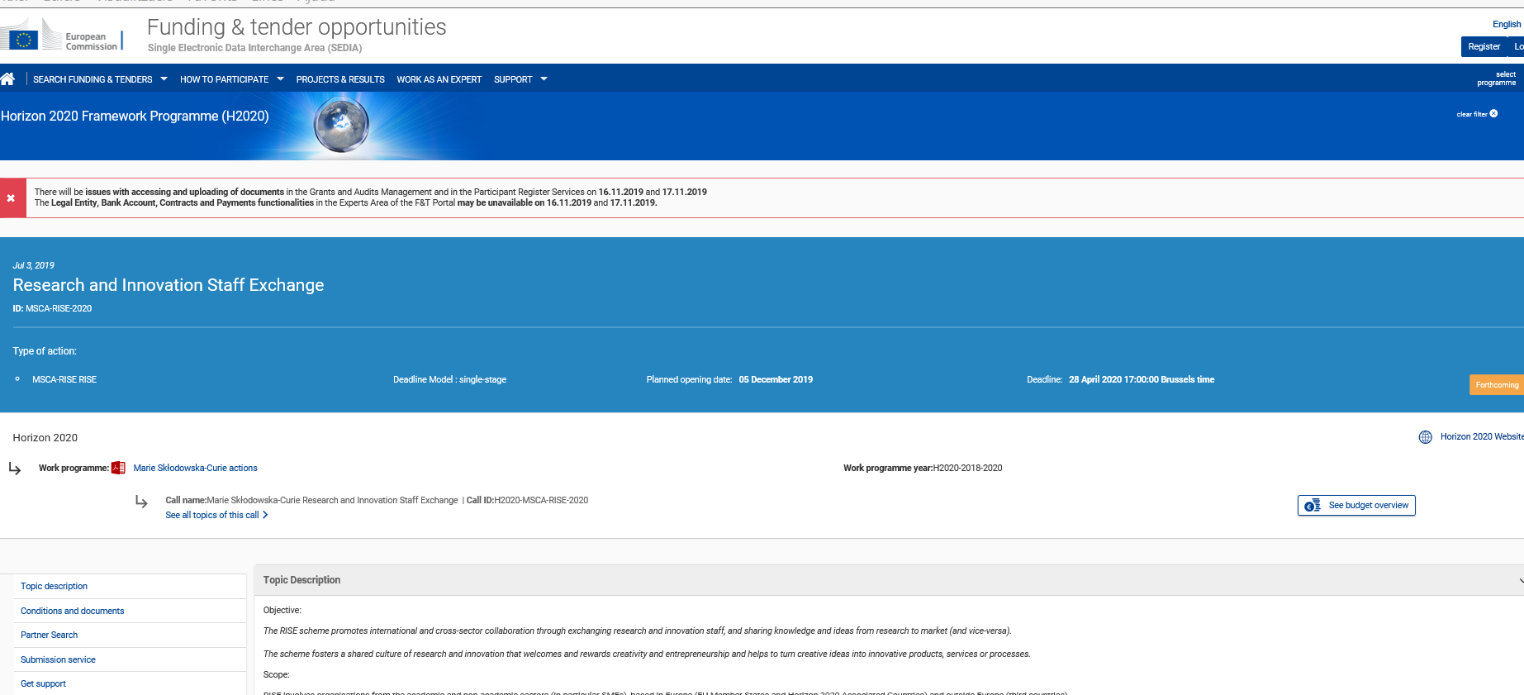
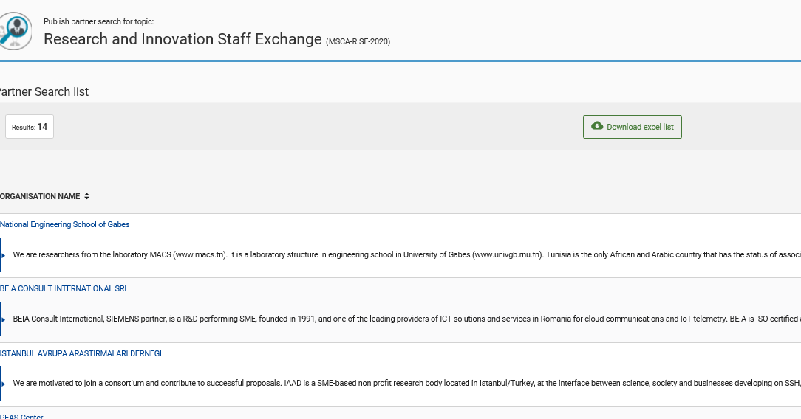
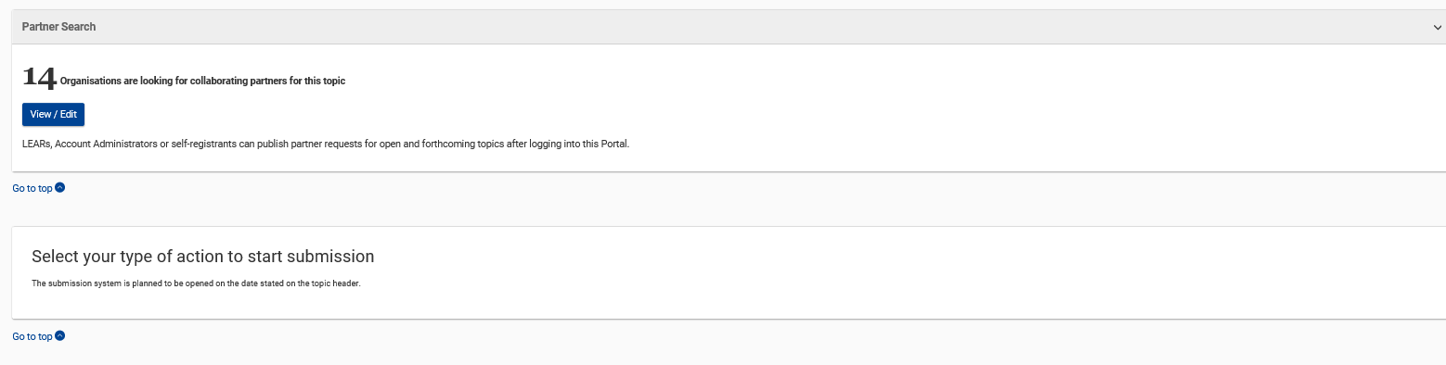
III. ¿Necesito encontrar socios?
Partner Search Tool on the RISE Call Page in the Funding and Tenders Portal

Slide 33
III. ¿Necesito encontrar socios?
Domain specific NCP example search platforms
MSCA: https://www.net4mobility.eu/eoi.html
ICT: http://www.ideal-ist.eu/partner-search/pssearch
Nanotechnologies: https://www.nmp-partnersearch.eu/index.php
Pharmaceuticals: https://cloud.imi.europa.eu/web/eimi-pst
Environment: http://www.irc.ee/envncp/?page=search
Social Science & Humanities: http://net4society.eu/public/pss.php
Nanotechnologies, advanced materials, advanced manufacturing and processing, biotechnology: http://www.nmpteam.com/
Space: http://ncp-space.net/
Health: http://www.healthncp.net/health-ncp-net-hnn-20
Food/agriculture/marine and maritime and inland water Research/bioeconom:
https://www.ncp-biohorizon.net/
Energy: http://www.c-energy2020.eu/
Transport: http://www.transport-ncps.net/
Climate action: http://www.ncps-care.eu

Slide 34
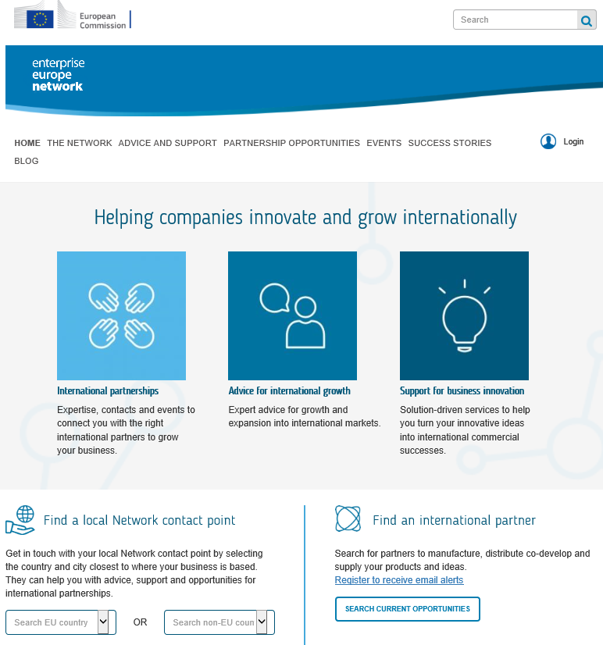

Enterprise Europe Network
III. ¿Necesito encontrar socios?
www.een-madrid.es
The Enterprise Europe Network helps businesses innovate and grow on an international scale.
It is the world’s largest support network for small and medium-sized enterprises (SMEs) with international ambitions.
The Network is active in more than 60 countries worldwide. It brings together 3,000 experts from more than 600 member organisations – all renowned for their excellence in business support.
https://een.ec.europa.eu
/

Slide 35

II. Aspectos generales a tener en cuenta
As a consortium:
  Capacity of the participants: clearly demostrated
  Coherence of the network
  Discuss the allocation of Institutional Unit Cost beforehand
  Plan a consortium agreement incluing IPR and research integrity issues, set a rule to solve conflict management
Help evaluators:
  “A picture is worth a thousand words”: use visuals to provide global information at a glance.
  Be aware of all criteria weight, it is not all about Excellence!
  Be precise – less is sometimes more; structure the proposal well (follow template)
35

Slide 36
III. Aspectos generales a tener en cuenta
Read the Call Documents:
  Work Programme, Guide for Applicants, Horizontal Issues: Gender / Ethic Issues
  Pay attention to the mandatory requirements of particular modes
Ask for support:
  Colleagues
  European Projects Offices / Transfer of Technology Offices / HR Departments …
  National Contact Points
Do not leave it for the last minute!
  Get familiar with the Participants´Portal
  Upload a version, you will be able to rewrite it.
….and success doesn´t always come on the first attempt
36

Slide 37
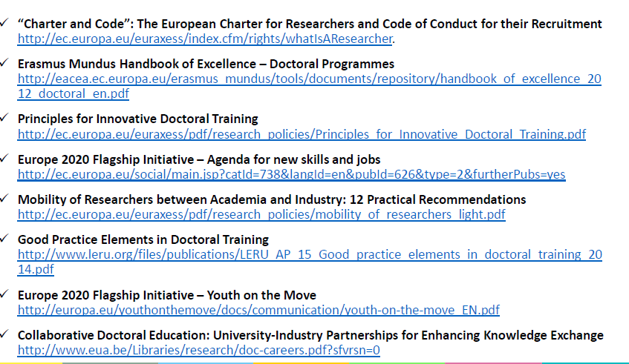
III. Enlaces sobre políticas europeas

Slide 38



III. Enlaces: CHARTER AND CODE
2 Key Documents: “Charter and Code”
European Charter for Researchers
The Code of Conduct for the Recruitment of Researchers
http://ec.europa.eu/euraxess/pdf/brochure_rights/eur_21620_es-en.pdf
HR Excellence in Research (HRS4R)
Have the organisations implemented it? In the process of obtaining the HR Excellence in Research? Explain it.
Use the OTM-R toolkit!
http://ec.europa.eu/euraxess/index.cfm/rights/strategy4Researcher

Slide 39

III. Enlaces: ¿cómo incluir género en los proyectos?
http://ec.europa.eu/research/gendered-innovations/
"Gendered Innovations"
employs methods of sex and gender analysis to create new knowledge.
GenPORT
On-line community of practionners for sharing knowledge and inspire collaboration
www.genderportal.eu
Gender Toolkit
http://www.yellowwindow.be/genderinresearch/
Cost Action GenderSTE
http://www.genderste.eu
More videos:
Introduction to Gendered Innovations
https://www.youtube.com/watch?v=aoGqpvO27QQ&feature=youtu.be
Definition of sex and gender & how sex and gender interact
https://www.youtube.com/watch?v=nETPIfrIf0A&feature=youtu.be
Understanding gender dimension for MSCA projects
https://www.youtube.com/watch?v=Hq4eWo30RfY

Slide 40
III. Enlaces: aspectos de Comunicación y Difusión
Communicating EU Research & Innovation - Guidance for project participant"
http://ec.europa.eu/research/participants/data/ref/h2020/other/gm/h2020-guide-comm_en.pdf
The Plan for the Exploitation and Dissemination of Results in Horizon 2020
https://www.iprhelpdesk.eu/sites/default/files/newsdocuments/FS-Plan-for-the-exploitation-and-dissemination-of-results_1.pdf
Outreach and Communication Activities in the MSCA under Horizon 2020
http://ec.europa.eu/assets/eac/msca/documents/documentation/publications/outreach_activities_en.pdf
Guidelines on Open Access to Scientific Publications and Research Data in Horizon 2020
https://ec.europa.eu/research/participants/data/ref/h2020/grants_manual/hi/oa_pilot/h2020-hi-oa-pilot-guide_en.pdf
Open Access in Horizon 2020
https://www.openaire.eu/h2020openaccess/

Slide 41


¡Muchas gracias!

