Slide 1

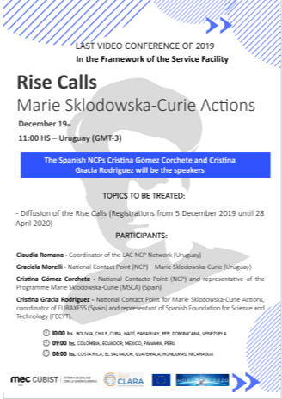

Acciones RISE
Marie Sklodowska-Curie (MSCA)
Horizonte 2020
Madrid, 19 de diciembre 2019
Cristina Gracia, Punto Nacional de Contacto MSCA
FECYT

Slide 2

CONTENT
H2020 Support in Spain
General aspects of Marie Sklodowska-Curie Actions (MSCA)
MSCA RISE

Slide 3
I. MSCA Support in Spain

Slide 4

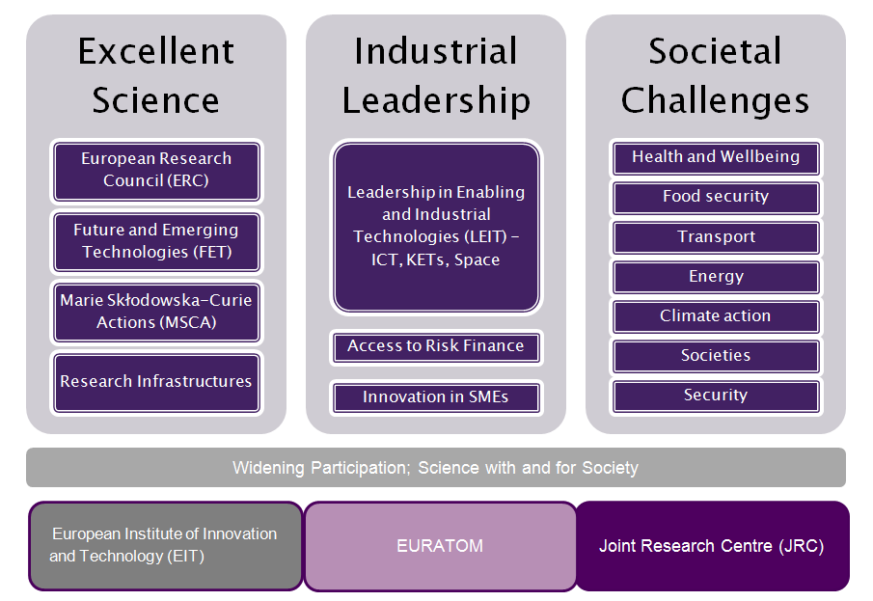
I. Horizon 2020 and MSCA
4

Slide 5


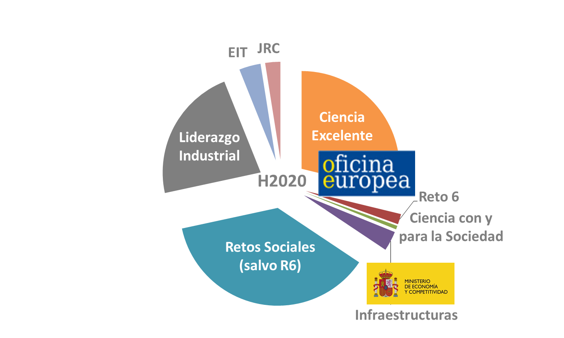
I. The European Office
Objective
Promote the participation and leadership of the Spanish R&I system in H2020.
Areas
Target group
EXCELLENT SCIENCE: ERC, MSCA, FET
SWAFS
Challenge 6
COST
OPIs, Universities, public R&I centres

Slide 6
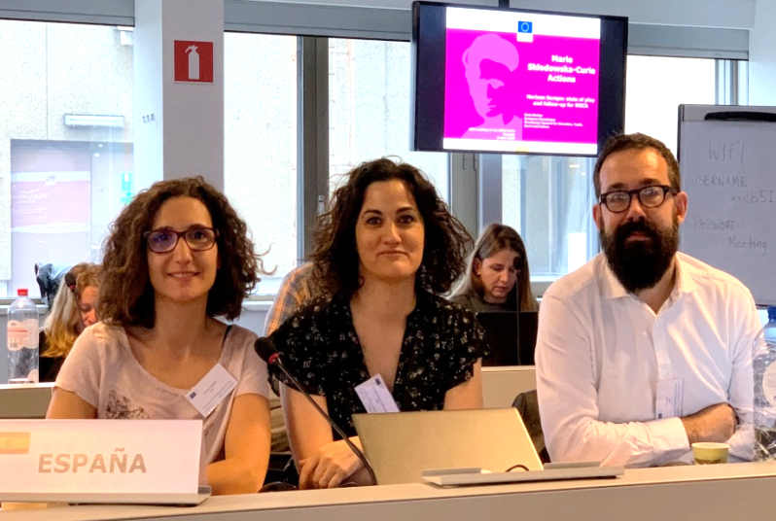
I. MSCA NCP Support Team
msca@oficinaeuropea.es
Informative and training sessions
Queries solving
Pre-screening of proposals
Managers Trained
MSCA Support
cristina.gomez@oficinaeuropea.es
jesus.rojo@madrimasd.org
cristina.gracia@fecyt.es

Slide 7


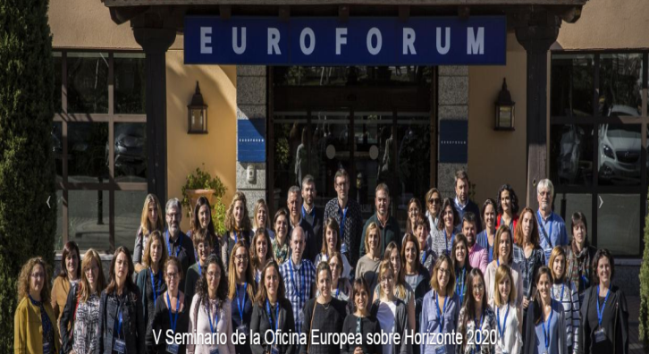

I. MSCA NCP Support Team 2014-2018
Informative sessions/Workshops /Meetings
+ 14.900 queries solved
467 events
+ 9.300 participants
+ 200 EU trained in MSCA
+ 609 proposals pre-screened

Slide 8
II. General aspects MSCA

Slide 9
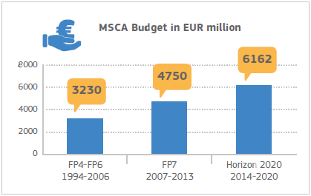
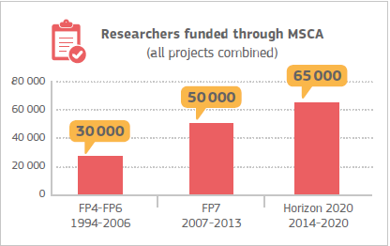
II. MSCA Basics
Excellent Science Pillar – Horizon 2020 (6,1M€)
Funding based on Unit Costs
Bottom-up approach
Open to all nationalities, career stages, and sectors
Annual Calls and excellent funding (usually 100%)
Prestigious programme with high visibility
100k+ researchers and 5k+ organisations
9 Nobel Prize winners
CHE | SOC | ECO | ENG | ENV | LIF | MAT | PHY
9
Notes:
Hay que ajustar las propuestas a uno de estos 8 paneles si bien veremos más adelante que en ITN hay además dos paneles multidisciplinares.
Intersectorial: esta es una de las moviilidades intersectoriales o la participación del sector no académico como se define en este programa es más importante. Par CAPACITAR a los investigadores en habilidades trasnversales más allá del laboratorio potenciando así su futura empleabilidad.
Hacer visible lo que se está haciendo con fondos públicos.

Slide 10
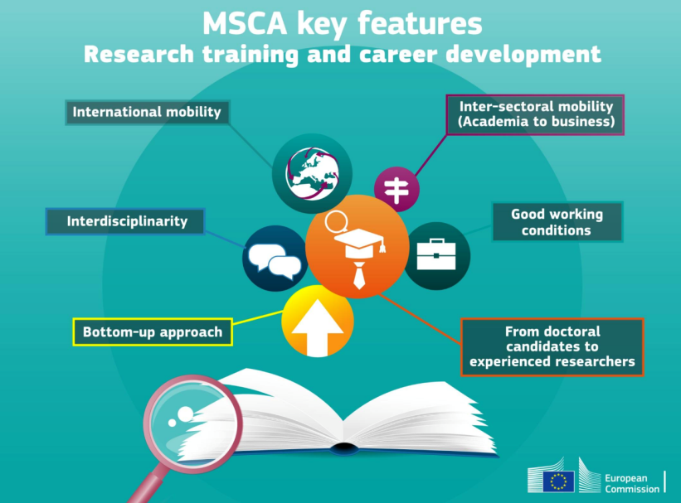
II. MSCA: some key concepts
  Triple “i” Mobility
  Strong industry participation
  Emphasis on communication and public engagement activities
  Strong focus on career development; adquisition of new and complementary skills
  Excellent working conditions, gender balance and open recruitment
10
Notes:
Hay que ajustar las propuestas a uno de estos 8 paneles si bien veremos más adelante que en ITN hay además dos paneles multidisciplinares.
Intersectorial: esta es una de las moviilidades intersectoriales o la participación del sector no académico como se define en este programa es más importante. Par CAPACITAR a los investigadores en habilidades trasnversales más allá del laboratorio potenciando así su futura empleabilidad.
Hacer visible lo que se está haciendo con fondos públicos.

Slide 11
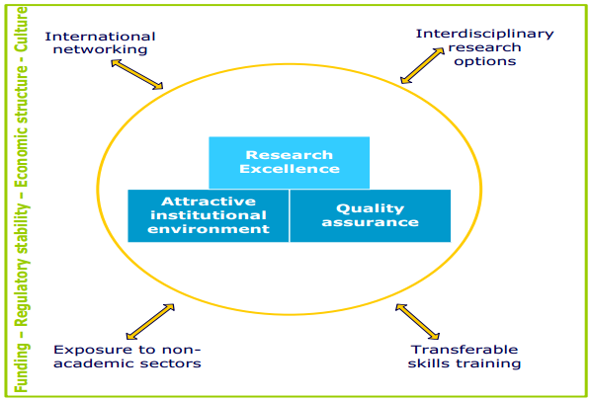
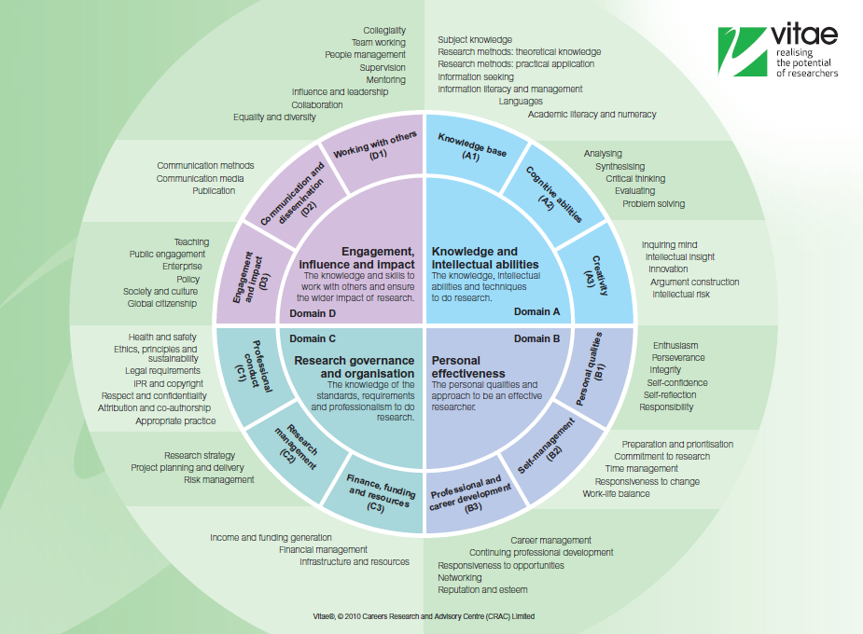
II. MSCA: focus on researchers’ career development
7 principles for Innovative Doctoral Training
Research Development Framework RDF (ej: VITAE)
http://ec.europa.eu/euraxess/pdf/research_policies/Principles_for_Innovative_Doctoral_Training.pdf
http://ec.europa.eu/euraxess/pdf/research_policies/SGHRM_IDTP_Report_Final.pdf
http://www.euraxess.es/eng/european-projects/pipers-policy-into-practice-euraxess-researcher-skills-for-career-development

Slide 12
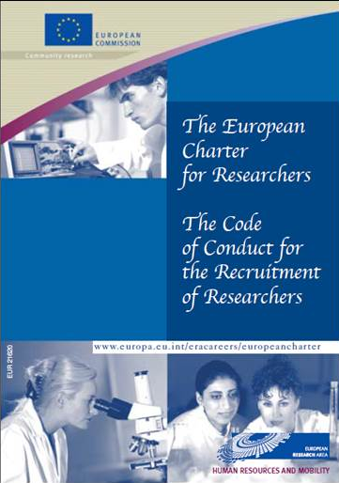
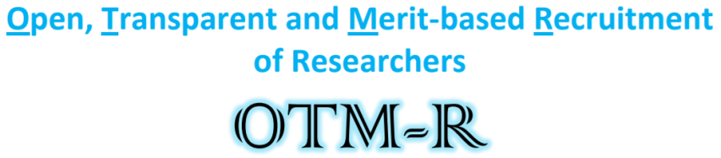


II. MSCA: excellent working conditions
The European Charter for Researchers is a set of general principles and requirements which specifies the roles, responsibilities and entitlements of researchers as well as of employers and/or funders of researchers.
The Code of Conduct for the recruitment of researchers consists of a set of general principles and requirements that should be followed by employers and/or funders when appointing or recruiting researchers.

Slide 13
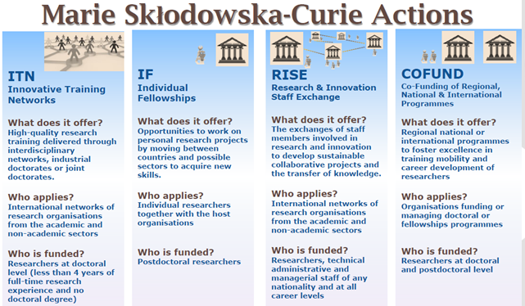
II. 2018-2020 MSCA Calls: 2.871M€ / 6.162M€ H2020
13

Slide 14

III. Research and Innovation Staff Exchange

Slide 15







IV. RISE
Promoting international and inter-sector research collaboration and knowledge transfer through staff exchange
OBJECTIVES
CROSS BORDERS
Transfer of Knowledge
Countries
Collaborations international & intersectoral
Sectors
Research & Innovation Staff Exchanges
Disciplines

Slide 16

Research and Innovation Staff Exchange
Network: Joint research project implemented through the international secondments.
Who? Minimum 3 independent organisations from 3 different countries; 2 of which MS/AC
How long? Projects up to 48 months
  What is funded? Staff exchanges (1-12 months); Funding for mobility costs, not salary
  Maximum funding: 540 person-months (2.48 million Euro )
Success rate (2019): ~25%
Budget available (2020): €80m
Deadline (2020): April 20th
Notes:
RISE consortium has a minimum 3 independent organisations from 3 different countries where 2 of which are MS/AC
There is no typical size or optimal structure of RISE consortia but the quality of implementation and impact are expected
Project built on the research and innovation
Basic Research, Applied Research, research and development,
but also innovation, support entrepreneurship and help to turn creative ideas into innovative products, services or processes
Project implemented by the secondment of staff (no recruitments)
Each member of staff seconded for a period of minimum 1 to maximum 12 months
The maximum duration of the project is 4 years
The maximum project size is 540 person / months (up to 2.430.000M€)

Slide 17
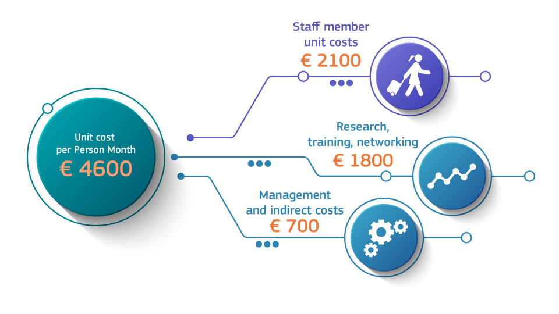
III. RISE: funding

Slide 18



III. RISE Actors: Beneficiaries, Partner Organisations, Staff seconded
BENEFICIARIES
- In Member State (MS) or H2020 Associated Country (AC)
- Sign the Agreement with the EC
- Claim costs*
- Responsible for overall implementation
*also for TC with funding
THIRD COUNTRY PARTNER ORGANISATIONS
- In Third Country (TC)
- Do NOT sign Grant
- Do NOT Claim costs
- Letter of Commitment required for project implementation
SECONDED STAFF
- R&D&I related activities
- Active at the host for longer than 1 month previous to secondment
- Experienced researcher, early stage researcher, management, technician

Slide 19

III. RISE: Country participation
Minimum 3 independent organisations from 3 different countries; 2 of which MS/AC
      Any country can participate in RISE (not all are eligible for funding)
27 Member States (MS) + ultraperiferic territories
Eligible to participate as Beneficiaries and Partner Organisations
* Iceland, Norway, Albania, Bosnia and Herzegovina, Former Yugoslav Republic of Macedonia, Montenegro, Serbia, Turkey, Israel, Moldova, Switzerland, Faroe Islands, Ukraine, Tunisia, Georgia, Armenia (as of November 2016)
16 Associated Countries to H2020 (AC) *
A. Eligible to receive funding: established in Annex A WP
B. Countries not eligible for EU funding
Participation varies depending on MSCA Modes
Third Countries: Not MS / Not AC

Slide 20

III. RISE: Country participation
https://ec.europa.eu/research/participants/data/ref/h2020/other/wp/2018-2020/annexes/h2020-wp1820-annex-ga_en.pdf
LIST OF ANNEXES
Legal entities established in the following countries and territories will be eligible to receive funding through Horizon 2020 grants:
Afghanistan, Algeria, American Samoa, Angola, Argentina, Azerbaijan, Bangladesh, Belarus, Belize, Benin, Bhutan, Bolivia, Botswana, Burkina Faso, Burundi, Cambodia, Cameroon, Cape Verde, Central African Republic, Chad, Chile, Colombia, Comoros, Congo (Democratic People’s Republic), Congo (Republic), Costa Rica, Côte d’Ivoire, Cuba, Djibouti, Democratic People's Republic of Korea ,Dominica, Dominican Republic, Ecuador, Egypt, El Salvador, Eritrea, Ethiopia, Fiji, Gabon, Gambia,, Ghana, Grenada, Guatemala, Guinea, Guinea-Buissau, Guyana, Haiti, Honduras, Indonesia, Iran, Iraq, Jamaica, Jordan, Kazakhstan, Kenya, Kiribati, Kosovo*, Kyrgyz Republic, Lao, Lebanon, Lesotho, Liberia, Libya, Madagascar, Malawi, Malaysia, Maldives, Mali, Marshall Islands, Mauritania, Mauritius, Micronesia, Mongolia, Morocco, Mozambique, Myanmar, Namibia, Nepal, Nicaragua, Niger, Nigeria, Pakistan, Palau, Palestine**, Panama, Papua New Guinea, Paraguay, Peru, Philippines, Rwanda, Samoa, Sao Tome and Principe, Senegal, Seychelles, Sierra Leone, Solomon Islands, Somalia, South Africa, South Sudan, Sri Lanka, St. Kitts and Nevis, St. Lucia, St. Vincent and the Grenadines, Sudan, Suriname, Swaziland, Syrian Arab Republic, Tajikistan, Tanzania, Thailand, Timor-Leste, Togo, Tonga, Turkmenistan, Tuvalu, Uganda, Uruguay, Uzbekistan, Vanuatu, Venezuela, Vietnam, Yemen, Zambia, Zimbabwe

Slide 21
III. RISE: sectors participation
ACADEMIC SECTOR
public or private High Education Institutions (HEI) awarding academic degrees
NON –ACADEMIC SECTOR
Any other socio-economic actor not included in the academic sector definition (i.e: SMEs, enterprises, NGOs, hospitals, government bodies, museums…)
public or private non-profit research organisations whose principal mission is research
International European interest organisations (IEIOs) http://eiroforum.org/

Slide 22



III. RISE: staff seconded and secondments
STAFF
Must be active at their host in research and innovation activities for 1 month before secondment.
Categories: Experienced researcher, early stage researcher, administrative, management and technician.
Must be reintegrated after secondments (no duration or mechanism specified)
During the secondment period, STAFF must be devoted 100% to RISE
SECONDMENTS
Duration: 1 – 12 months.
Split-stays possible: i.e. an ESR travels for 2 weeks in Month 6 and 2 weeks in Month 16 to the same organisation = 1 month-secondment.
      Funding per month of secondment: 2100€ Researcher Unit Cost + 2500€ Institutional Unit cost.
      Additional rules in order to seek internationality and intersectorality.

Slide 23
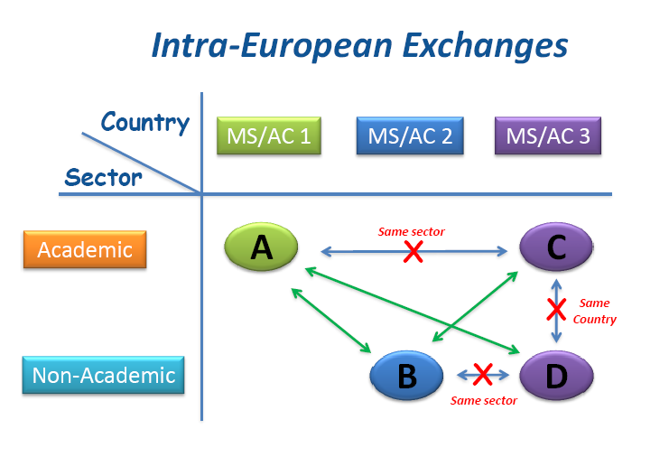
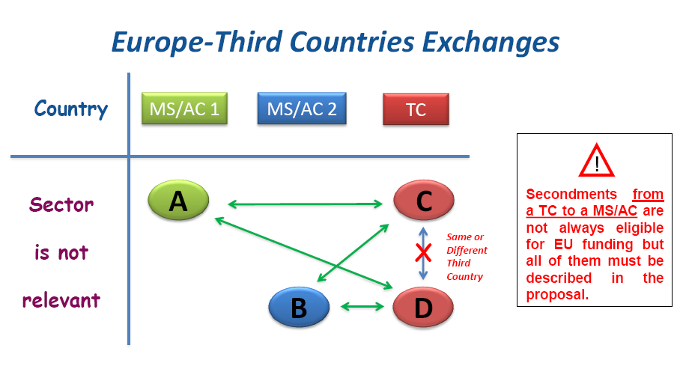



III. MSCA calls: Research and Innovation Staff Exchange (RISE)
      At least 3 participants in 3 countries:
All MS/AC: 3 beneficiaries in 3 MS / AC, at least 1 academic and 1 non-academic
Including TC: 2 beneficiaries in 2 MS / AC y 1 P.O. in a TC, independent from the sector they belong to
IntraEuropean Secondments between different countries and sectors: academic and non-academic
- Secondments of MS/AC to TC
- Secondments between TC
- Secondments of TC (B. High Income) to Europe (no funding).
- Secondments in the same country
- Secondments within the same sector
in Europe

Slide 24
III. RISE: secondments

Slide 25

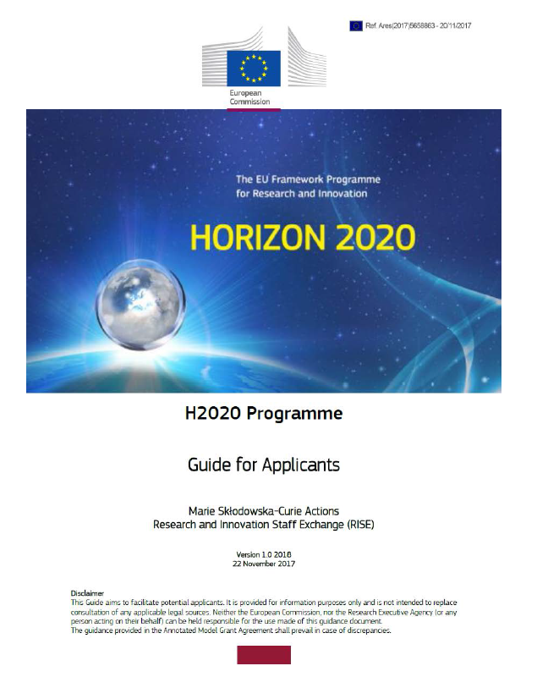
Reference Documents
Tip 1: Read all relevant documentation
Notes:
Tip 1 = read the documents well
Guide for applicants as the key document
Work programme
Grid, links to FAQs

Slide 26
Tip 2: Refer well to evaluation criteria
=
(E + I)^{Impact}
Excellence Implementation are closely interlinked!
Notes:
TIP 1 – described the project carefully to meet all criteria!
A successful RISE project = combination of excellence (E) in the research and innovation activities and the quality and efficiency of the implementation (I) to derive maximal Impact (Im).
In particular:
1. Implementation plans
In applications please pay attention to how you describe your implementation plan.
The R&I project is built around secondments, therefore, once you have your idea then you have to design the plan for how to allocate resources and make the most of the different competencies in the consortium for the various WP and tasks.
2. Secondments
For the secondments we only ask for indicative tables of the exchanges for the duration of the project.
3. Outputs
Research, training, transfer of knowledge, workshops, reports, relevant scientific deliverables
reach goals for each work package and to monitor progress.
The publications are linked to the deliverables and shall be reported along open access principles.
Dissemination and communication (impact)

Slide 27
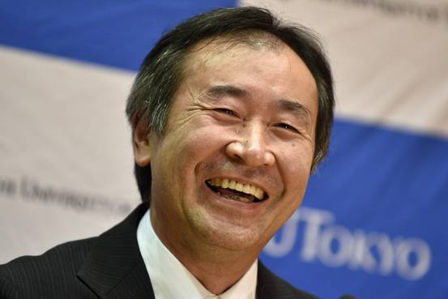
Tip 3: Be inspired by success stories!
Prof. Takaaki Kajita
Nobel Prize Winner in Physics, 2015
"for the discovery of neutrino oscillations, which shows that neutrinos have mass"
SKPLUS
Super-Kamiokande plus
RISE 2014 (no. 641540)
EU contribution: €310,500.00
Coordinator: Universidad Autonoma de Madrid (ES) + 3 beneficiaries from Europe working with the University of Tokyo (JP)
Investigating neutrino interactions using the Super-Kamiokande detector owned by the Institute for Cosmic Ray Research at the University of Tokyo, Japan
All seconded researchers working in Japan

Slide 28
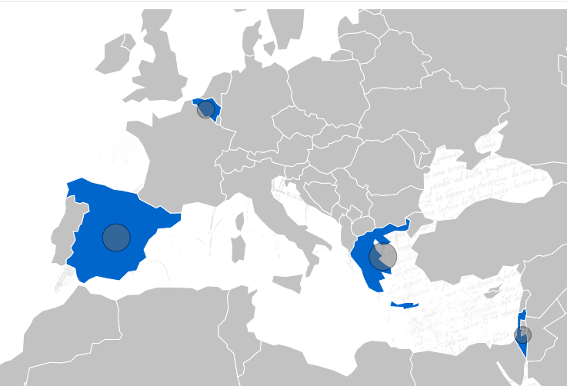
VIVOIMAG 645757
Bone implants: a new contrast agent sensitive to enzymatic activity of metal-proteases, which will permit for the first time to follow the integration and cell differentiation activity in bone tissue bioreactors in vitro and in grafts in vivo using existing non-invasive magnetic resonance imaging techniques.
UMONS
4
10
13
CSIC
8
6
5
13
BIOIMAG
DEMO
15
4
4
7
BET
8
4
EC Contribution = 472 500 EUR / 48 months
Funded Secondments = 105 researcher months
8
BONUS
Notes:
Areas of research: Diagnostic tools (e.g. genetic, imaging); Nanochemistry; Nanotechnology, nano-materials, nano engineering; Medical engineering and technology
The main objective of VIVOIMAG is to develop bone implants including a new contrast agent sensitive to enzymatic activity of metaloproteases, which will permit for the first time to follow the integration and cell differentiation activity in bone tissue bioreactors in vitro and in grafts in vivo using existing non invasive magnetic resonance imaging techniques. The proposal aims at integrating a magnetically functionalized extracellular matrix material into the bone scaffolds, seeding them with cells, implanting them in animal models and following the fate of the implants in vivo using MRI. The aim is to obtain similar results with the magnetically modified scaffolds as the ones obtained currently but having now endowed the grafts with enzymatic reporting activity that can be monitored noninvasively in the living animal. There are currently no methods to detect in situ and in vivo this enzymatic activity without previously sacrificing the transplanted animals, therefore the successful accomplishment of this project would have huge and prolonged impact in the medical field of tissue regeneration.
The VIVOIMAG project brings together a multidisciplinary consortium of specialists in different areas of bone implant research, nanoparticles formulation and characterization, magnetic resonance and scintigraphic imaging, who will join forces in order to propose and assess a novel technique for the evaluation of the progress of bone implants in vivo, which can substitute existing invasive techniques based on biopsies.
A well planned exchange program among academic and industrial partners will facilitate knowledge sharing, maximize collaborative work and finally achievement of project objectives. The consortium, being aware of the scientific and social importance of bone tissue engineering, has planned a series of dissemination and training activities, aiming at making project knowledge and outcomes available to the scientific community and society.
CONSORTIUM
1 NATIONAL CENTER FOR SCIENTIFIC RESEARCH "DEMOKRITOS" DEMO Greece
2 AGENCIA ESTATAL CONSEJO SUPERIOR DE INVESTIGACIONES CIENTIFICAS CSIC Spain
3 UNIVERSITE DE MONS UMONS Belgium
4 BONUS THERAPEUTIC LTD BONUS Israel
5 BIOIMAG SOLUCIONES DE CONTRASTE SL Bioimag Spain
6 TEXNOLOGIKES LYSEIS BIOEKPOMPIS OE BETSolutions Greece

Slide 29
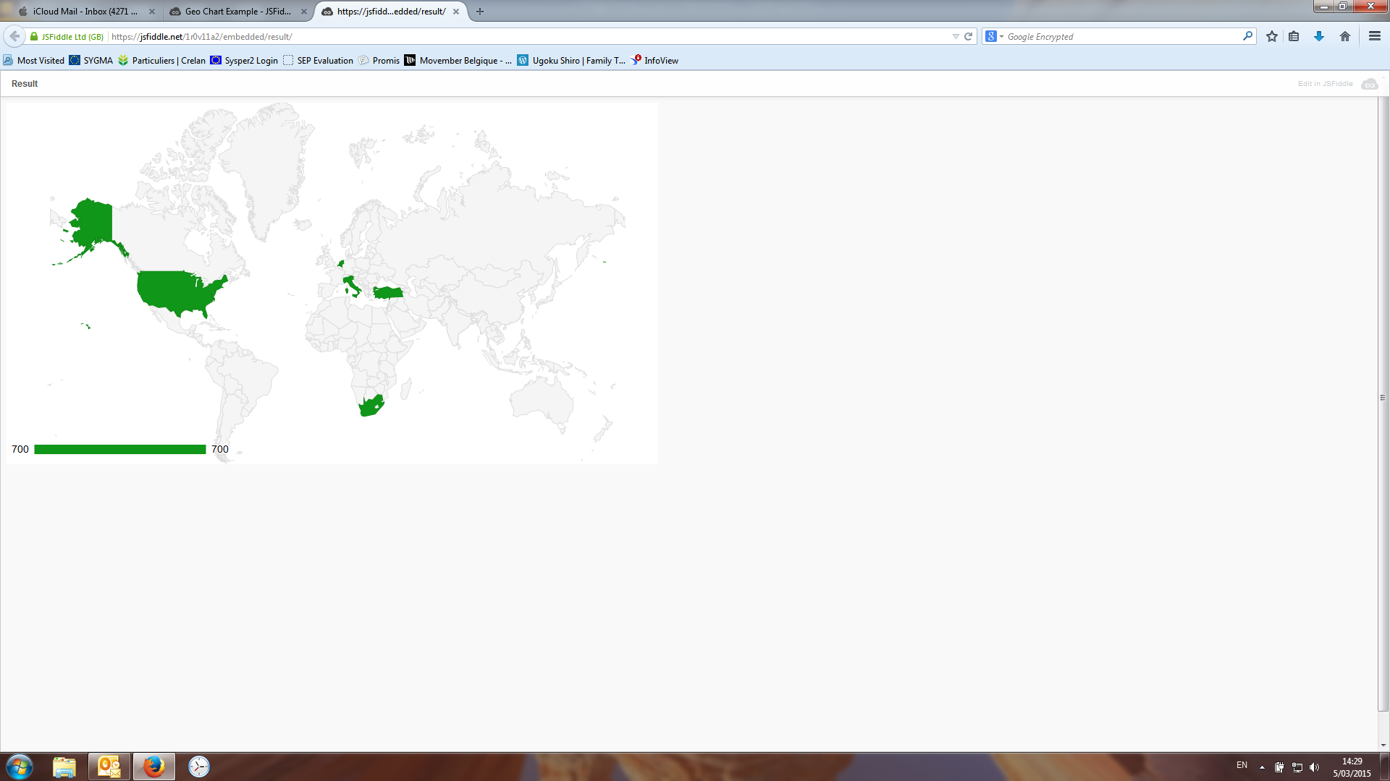
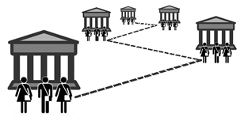
GREEN BUBBLES 643712
Objective: to maximise the benefits associated with diving while minimising its negative impacts, thus achieving the environmental, economic and social sustainability of the system.
NHTV
UNIVPM
GAIA
COE
UBICA
UBICA
BURC
DANEU
6
EC Contribution = 1 611 000 EUR / 48 months
Funded Secondments = 358 researcher months
NWU
DANSA
Notes:
Research fields: Education: systems and institutions, teaching and Social economics; Environment, resources and sustainability; Computer games, multi-media, augmented and virtual
Recreational SCUBA diving has become a mass leisure activity engaging millions of divers worldwide. The diving industry generates large direct and indirect revenues for coastal communities and Marine Protected Areas (MPAs). Other benefits linked to diving include the promotion of ocean stewardship, contribution to scientific research, fostering social inclusion and personal development. Yet, diving has also negative impacts, due to damage or disturbance of marine habitats and organisms and to conflicts with local communities for the access to/use of the same resources, equity issues, or cultural clashes. These aspects clearly relate to the three pillars of sustainability, covering environmental, economic and social dimensions and can only be addressed by a systemic approach.
The central objective of GREEN BUBBLES is to maximise the benefits associated with diving while minimising its negative impacts, thus achieving the environmental, economic and social sustainability of the system. This will be done by: 1) Carefully assessing and modelling the system itself; 2) Developing innovative products based on the issues and needs highlighted by assessment and modelling; 3) Promoting the uptake of such products by the system designing tailored business models and marketing plans. Direct engagement with selected stakeholders (divers, professionals, diving operators, certification agencies - CAs, MPAs, NGOs) will ensure relevant feedback throughout the project’s lifetime, as well as effective uptake of results at the end of the project. Cutting across sectors and disciplines, and engaging participants from 3 continents, GREEN BUBBLES will put the European diving system in focus thanks to dedicated R&I with, about and for the European diving industry and will take advantage of parallel comparative work on the much more studied coral reef diving system.
CONSORTIUM
1 UNIVERSITA POLITECNICA DELLE MARCHE UNIVPM Italy
2 STUDIO ASSOCIATO GAIA SNC DEI DOTTORI ANTONIO SARA E MARTINA MILANESE GAIA Italy
3 UBICA SRL UBICA Italy
4 BOGAZICI ULUSLARARASI EGITIM DANISMANLIK MERKEZI VE TICARET LIMITED SIRKETI BURC Turkey
5 Divers Alert Network Europe Foundation DANEU Malta
6 STICHTING NHTV INTERNATIONALE HOGESCHOOL BREDA NHTV Netherlands
7 NOORDWES-UNIVERSITEIT ZA
8 COE THE COLLEGE OF EXPLORATION US
9 DANSA DIVERS ALERT NETWORK SOUTHERN AFRICA ZA
10 SU BOARD OF TRUSTEES OF THE LELAND STANFORD JUNIOR UNIVERSITY US

Slide 30
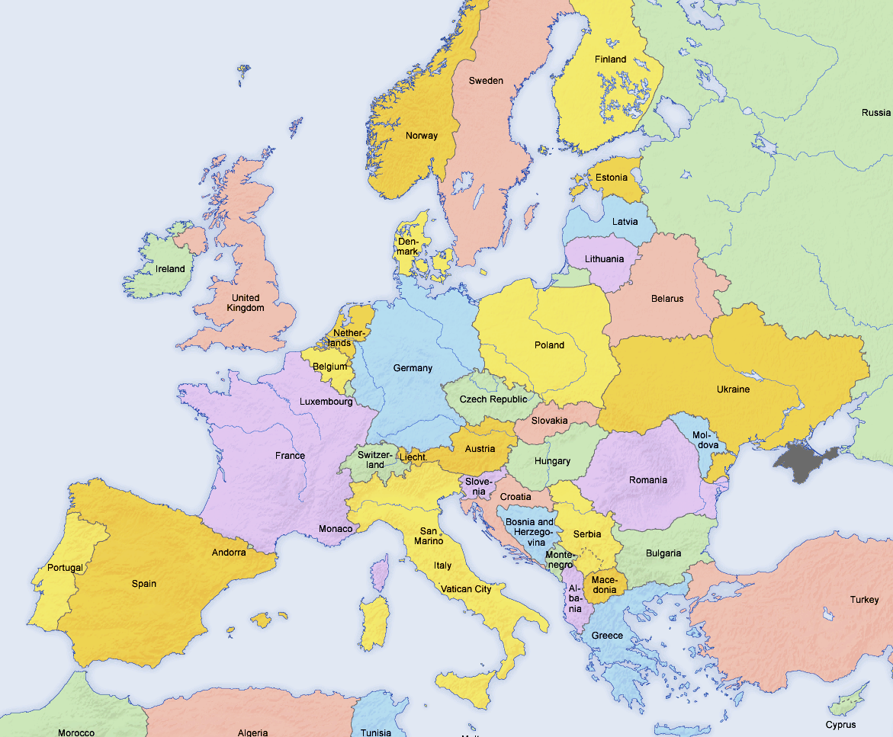
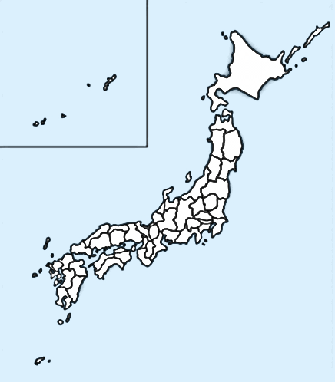
JENNIFER 644294
Searching signals of new physics both with neutrinos, at T2K experiment, and at the intensity frontier, with the Belle-II experiment at the SUPERKEKB machine, to play a primary role in the search for deviations from the actually known fundamental physics in the flavour sector and to produce an unprecedented collaboration with Japanese scientists on the ground of dissemination and outreach.
KEK
STFC
QMUL
NCBJ
DESY
IFJ
UKP
6
1
OEAW
CNRS
JSI
INFN
IFAE
CAEN
METU
EC Contribution = 2 308 500 EUR / 48 months
Funded secondments = 513 researcher months
Notes:
Research field: Fundamental interactions and fields; Particle physics
European particle physics groups interested in searching signals of new physics both with neutrinos, at T2K experiment, and at the intensity frontier, with the Belle-II experiment at the SUPERKEKB machine, want to share between them and with KEK laboratory their knowledge in data analysis and detector technologies. Such knowledge sharing will enhance skills and competences of all participants, will allow Europe to play a primary role in the search for deviations from the actually known fundamental physics in the flavour sector and, last but not least, will produce an unprecedented collaboration with Japanese scientists on the ground of dissemination and outreach.
CONSORTIUM
1 ISTITUTO NAZIONALE DI FISICA NUCLEARE INFN Italy
2 STIFTUNG DEUTSCHES ELEKTRONENSYNCHROTRON DESY DESY Germany
3 OESTERREICHISCHE AKADEMIE DER WISSENSCHAFTEN OEAWHEPHY Austria
4 THE HENRYK NIEWODNICZANSKI INSTITUTE OF NUCLEAR PHYSICS, POLISH ACADEMY OF SCIENCES IFJ PAN Poland
5 UNIVERZITA KARLOVA V PRAZE UKP Czech Republic
6 INSTITUT JOZEF STEFAN JSI Slovenia
7 MIDDLE EAST TECHNICAL UNIVERSITY METU Turkey
8 CENTRE NATIONAL DE LA RECHERCHE SCIENTIFIQUE CNRS France
9 COMMISSARIAT A L ENERGIE ATOMIQUE ET AUX ENERGIES ALTERNATIVES CEA France
10 INSTITUTO DE FISICA DE ALTAS ENERGIAS IFAE Spain
11 NARODOWE CENTRUM BADAN JADROWYCH NCBJ Poland
12 QUEEN MARY UNIVERSITY OF LONDON QMUL United Kingdom
13 SCIENCE AND TECHNOLOGY FACILITIES COUNCIL STFC-RAL United Kingdom
14 COSTRUZIONI APPARECCHIATURE ELETTRONICHE NUCLEARI C.A.E.N. SPA CAEN Italy
15 KEK INTER-UNIVERSITY RESEARCH INSTITUTE CORPORATION, HIGH ENERGY ACCELERATOR RESEARCH ORGANISATION JP
16 U-Tokyo NATIONAL UNIVERSITY CORPORATION THEUNIVERSITY OF TOKYO JP

Slide 31

Tip 4: Start early!
H2020-MSCA-RISE call | 2020
Opening Date Closing Date | 5 DEC 2019 28 APR 2020
Budget | 80 million €
Notes:
Next MSCA RISE calls
Indicative budget and deadlines for the next 2 years

Slide 32
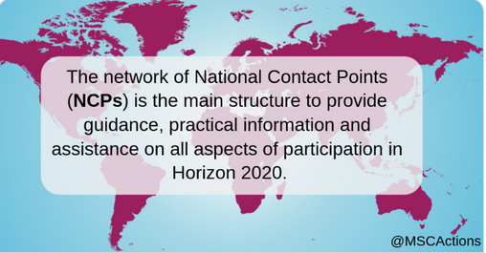
Tip 5: Be in touch with your NCP
https://www.net4mobilityplus.eu/contacts/
Credits
Icons: Freepik, www.flaticon.com
Images: Getty Images, iStock
Notes:
Thank you for your attention!
NCP + FMB contact

Slide 33
¡Muchas gracias!
Cristina Gracia
cristina.gracia@fecyt.es
Oficina Europea FECYT / MCIU
USEFUL LINKS
Research and Innovation Participants´Portal : http://ec.europa.eu/research/participants/portal/desktop/en/home.html
Web and Blog Marie Curie Sklodowska-Curie Actions: http://mariecurieactions.blogspot.com.es/ - http://www.madrimasd.org/blogs/msca
European Charter & Code: http://ec.europa.eu/euraxess/pdf/brochure_rights/eur_21620_es-en.pdf
EURAXESS Spain: http://www.euraxess.es
Net4mobility+ project: https://www.net4mobilityplus.eu/
Oficina Europea FECYT/MCIU: http://eshorizonte2020.es

